Slide 1
Reliable Data Transfer Protocols

Slide 2
Objective
Implement the reliable data transfer protocols (Alternating bit, Go-Back-N and Selective Repeat) to send multiple messages from sender to receiver.
Results:
Analysis of throughput for each protocol for different window sizes and different loss probabilities.

Slide 3
Alternating Bit
Alternating bit protocol sends one packet at a time and does not have a window to send multiple packets.
In this protocol, the packet sequence numbers alternate between 0 and 1.
If a sender receives a new packet to be transmitted when the previous packet is currently being transmitted to receiver then the sender should buffer the packet.
If a packet is lost or corrupted, the sender retransmits the lost packet after timeout and restarts the timer.

Slide 4
Go-Back-N
In Go-Back-N protocol, the sender can transmit multiple packets at a time without waiting for an acknowledgement within the window size.
In this protocol, the packet sequence numbers do not alternate between 0 and 1. Instead the sequence numbers for each packet increment by 1.
If a packet is lost then it is retransmitted after a timeout.
Also all the packets within the window that were transmitted after the lost packet, will be retransmitted to the receiver and the timer will be restarted.

Slide 5
Selective Repeat
In Selective Repeat protocol, the sender can transmit multiple packets at a time without waiting for an acknowledgement within the window size.
In this protocol, the packet sequence numbers do not alternate between 0 and 1. Instead the sequence numbers for each packet increment by 1.
If a packet is lost then it is retransmitted after a timeout. Also in Selective Repeat only the lost packet is retransmitted and not all packets within the window.
Out of order packets will be buffered until the lost packet is received at which point a batch of packets will be delivered to the receiver in order.

Slide 6
Timer Implementation
For each packet being sent, store the time sent for each packet in a Map.
When a packet has a timeout, resend the packet which had a timeout to receiver and update the time sent in the Map for that packet. Then subtract the difference of current time and the time stored for each packet in Map. The packet with minimum difference will timeout first so start timer for this packet
After receiving an acknowledgement, subtract the difference of current time and the time stored for each packet in Map from RTT. The packet with minimum difference will timeout first so start timer for that packet.

Slide 7
Results

Slide 8
 | LOSS
 | 0.1 | 0.2 | 0.4 | 0.6 | 0.8
Throughput | 0.019794 | 0.019945 | 0.01717 | 0.007339 | 0.001961
ABT
 | LOSS
 | 0.1 | 0.2 | 0.4 | 0.6 | 0.8
Throughput for Window size 10 | 0.072912 | 0.054731 | 0.036577 | 0.018448 | 0.009452
Throughput for Window size 50 | 0.073636 | 0.055460 | 0.037305 | 0.019165 | 0.010185
GBN
 | LOSS
 | 0.1 | 0.2 | 0.4 | 0.6 | 0.8
Throughput for Window size 10 | 0.019717 | 0.01446 | 0.000723 | 0.000272 | 0.000209
Throughput for Window size 50 | 0.020207 | 0.019998 | 0.020112 | 0.017402 | 0.00111
SR

Slide 9
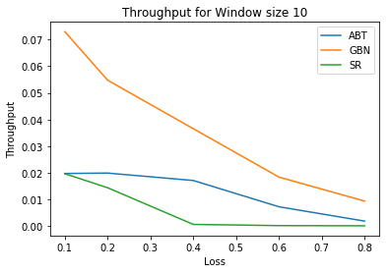
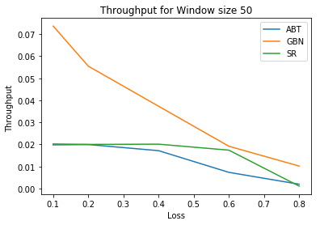
Comparison for different window sizes
Window size 10
Window size 50

Slide 10
Analysis
As the loss probability increases, the throughput for ABT, GBN (window sizes 10 and 50) and SR (window sizes 10 and 50) will decrease.
ABT
In ABT, the throughput decreases as loss probability increases.
GBN
In GBN, throughput decreases as loss probability increases.
SR
In SR, throughput decreases as loss probability increases.
But in SR, unlike GBN, even for larger windows, only lost packet is retransmitted which does not affect throughput as much as GBN.
Also for larger windows the packet retransmissions will be more if there is a packet loss which would affect throughput more.

